Slide 1

OMKAR AGRAWAL
Smart Agriculture based on IoT

Slide 2
Project Overview
The goal of this project is to build a smart Agriculture based on IOT.
Smart Agriculture System based on IoT can monitor soil moisture and climatic conditions to grow and yield a good crop.
Easier management over internet.

Slide 3
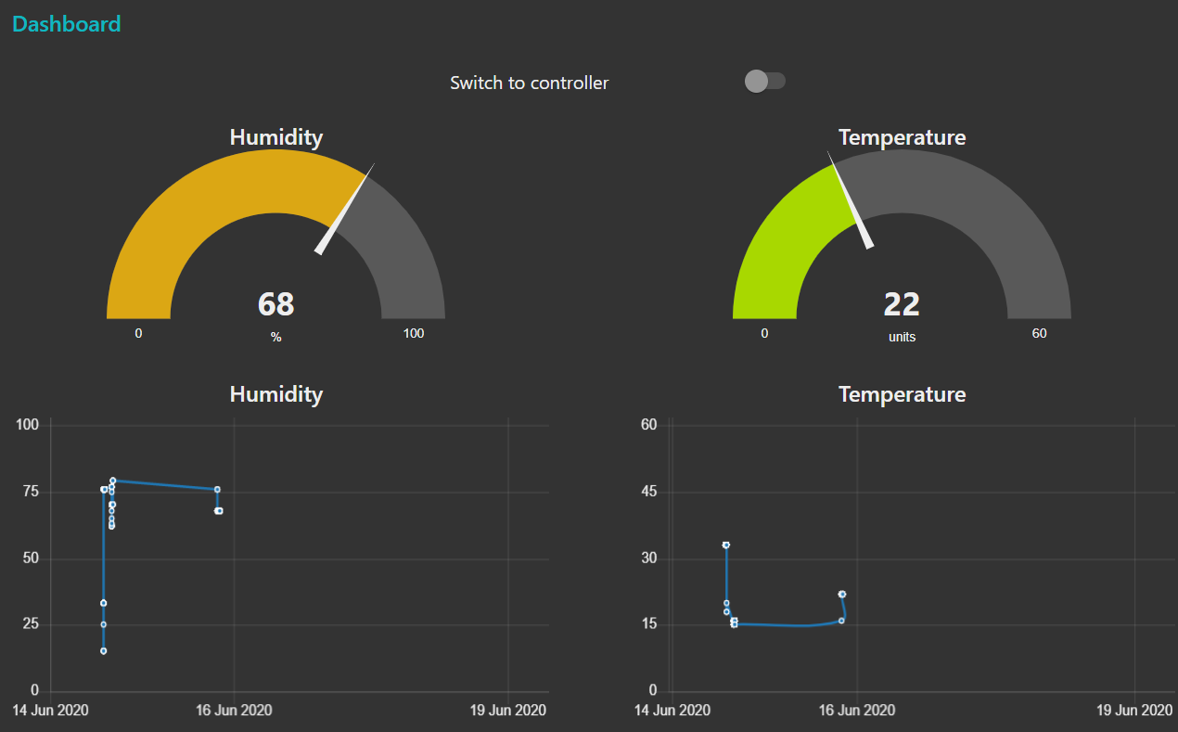
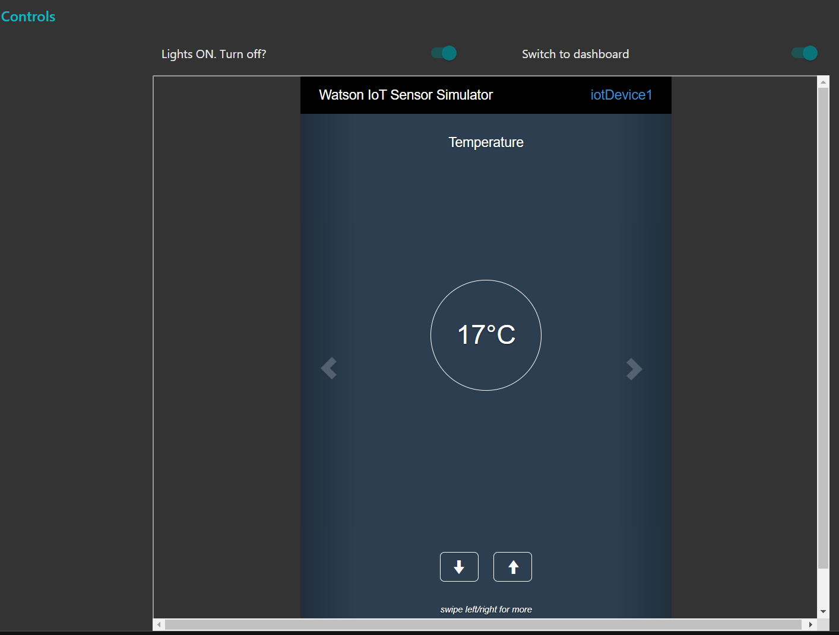
Project Overview

Slide 4
Technologies used in cloud
IBM IoT Platform
IBM Node-red App
IBM IoT platform automatically connects and receive data from IoT sensors.
One-time configuration and setup
Communicates with sensors and Cloud.
Deploys and manages node-red application over cloud
Always available online with ease and no pain to setup manually.
Connects IBM IoT platform with the dashboard.

Slide 5
Thank You

